Slide 1
Standard User – Initiate Contract from an Interview Wizard
February, 2013

Slide 2

Learning Objectives
Upon completion of this course you will be able to:
Understand the benefits of using a Contract Wizard
Initiate an Interview
Pause and Restart an Interview
Search for an Interview
Create a Contract from an Interview

Slide 3
Contract Interview Wizard Overview
The benefits of creating a contract via the interview wizard include:
  An alternative method to creating a contract manually
  A user-friendly interface for taking a user through the steps necessary to create a contract, with suggestions for the type of contract needed
    The sequence of steps itself can vary, based on responses to previous steps
    The default contract name, “Wizard...”, can be changed
  A user-friendly manner to allow a user different presentation options to enter Term values into a contract
  Faster contract generation with greater accuracy
    Typically there are no more than 4-5 screens, and few questions
  Actions can be specified to provide direction for a user to go to the appropriate steps to complete the interview

Slide 4


What is an Interview?
Interviews are used to guide users when creating contracts and entering contract values.
  Asks the user a question (for example, “What is the estimated global value?”)
  Provides an exit action based on the user’s response to a question
  Provides instructions for guiding the user on what selection to make
Interviews can:
  Enter Term values
  Set other values (Parties, Effective Dates, Lines, ...; however,
  Line values can only be entered on a cell-by-cell basis, as in the UI)
  Set relationships and attachments (could attach a spreadsheet
  containing Lines values to be uploaded later)
  Place or replace clauses (e.g., Yes → clause A is included; No → clause B)
  Create a Contract
Interviews cannot:
  Create more than one contract at once
  Perform workflow (such as review request)
  Perform any administrative tasks
  Create anything past first draft of a contract instance
The end result of an interview is ALWAYS a contract.

Slide 5
How is an Interview Created?
Only users with the appropriate security access have the ability to design and create interviews.
The Interview design process that is followed includes:
  Questions that need to be asked to the user (and the format in which they should be presented).
  Default answers, if any, for the above questions
  List of Terms to be filled in by the interview as a result of answers to the questions
  Conditions for including and excluding clauses
  Identification of any questions that are required in order to proceed to the next step
Because an interview incorporates contract tailoring, the ideal is to have the interview designed such that execution produces a contract that is ready to sign. Some negotiation is usually needed (typically, the contract is sent for Review right after creation), but at least you want all of the questions from the ECM customer's side to be addressed in the initial contract.
Contract Authors have basic interview functionality such as starting an interview from an existing Interview Wizard in order to create a contract.

Slide 6
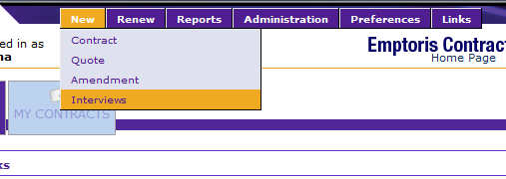
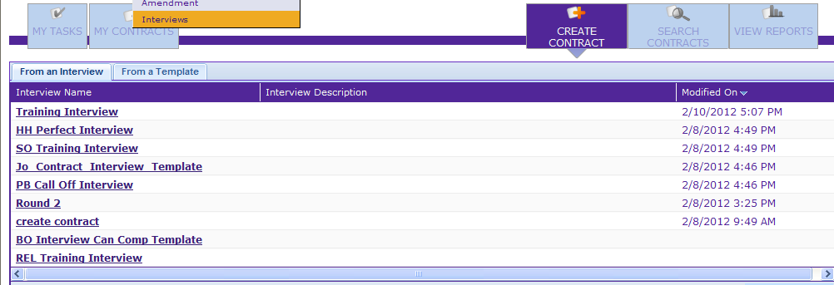
Starting an Interview
To run an Interview (or ‘Wizard’), select New > Interviews from the top menu bar.
-OR-
From the Contract Home Page, select the Create Contract button
Select From an Interview tab
Click on the Interview Name link

Slide 7
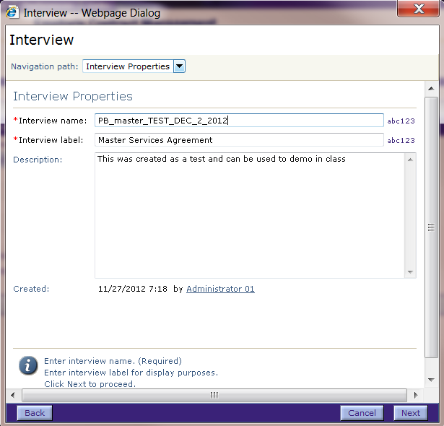
Initiate the Interview
The Interview dialog box opens.
  Your name, date and time are automatically appended to the Interview name.
  The name is an editable field and can be modified as needed.
  The Interview Name is confusing: it is not the name of the interview (design) that we just selected to run, nor is it the name of the contract that will be created. It is the name of an instance of the interview design that we're running, and is mostly of use in identifying the interview later, if we pause during execution.
Type a Description in the text box, if desired.
Click Next to continue.

Slide 8
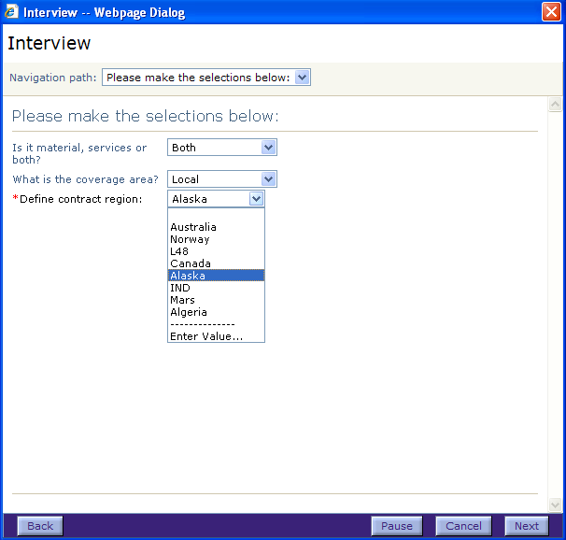
Navigate through the Questions
The interview presents a series of questions and allows information to be entered.
Navigate through the questions using the Next and Back buttons. The Next button is grayed out if a mandatory value is missing.
If you encounter script errors running
the wizard, it might be because you
went too fast through the prompts.
You can Pause the interview and
resume it at a later time.
You can also Cancel the interview
and return to the home page.

Slide 9
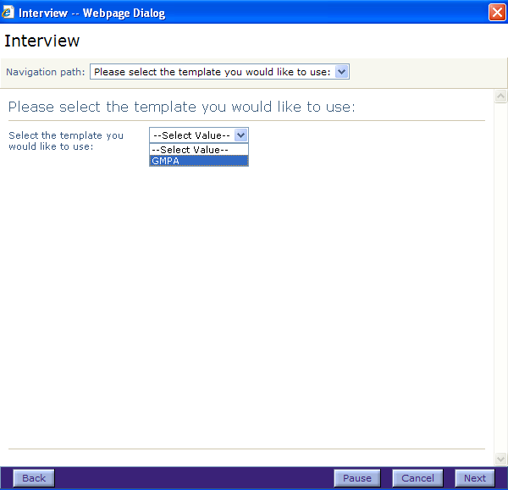
Answering the Interview Questions
There are many ways to answer the questions.
The interview may ask you to:
  select from a list
  enter text
  search for a file, or
  select from a calendar
Click Next to move to the next step.

Slide 10
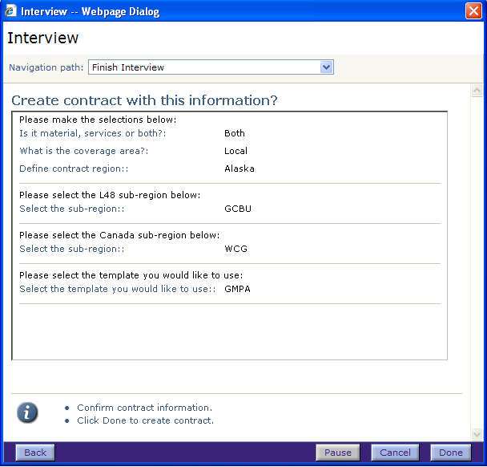
Interview Summary
After all of the questions have been answered, a Summary is displayed.
If you wish to change an answer,
click the Back button.
Click Done to finish the interview.
ECM creates the contract based
on the responses provided.

Slide 11
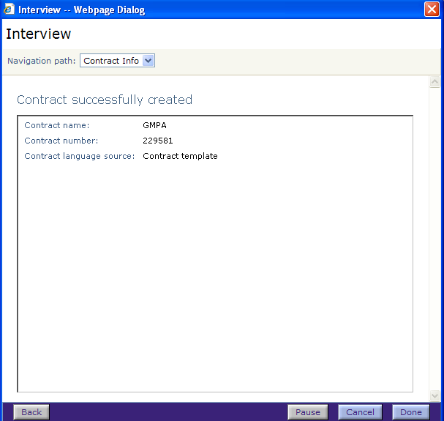
Contract Creation
A dialog box is displayed with the Contract Name and Number.
Click Done to exit
the Interview.

Slide 12

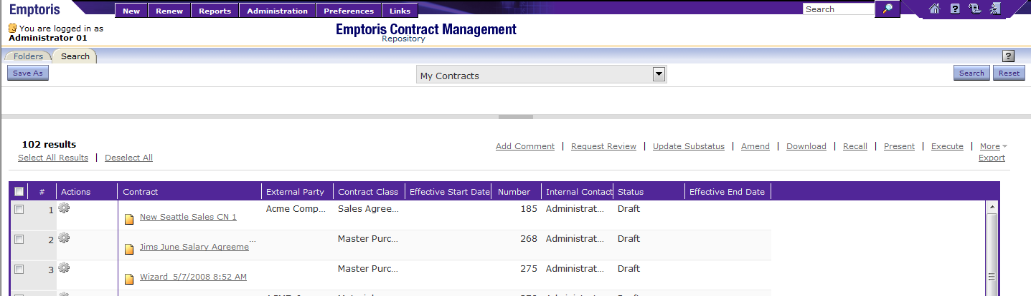
Home Page
Click My Contracts from the Home page.
The new contract is listed in the My Contracts list.
Click the contract name hyperlink to open the contract in the Contract Editor.
  You can then modify the Header and Parties information and view or modify the contract Language and Terms.

Slide 13

Questions?

